Slide 1
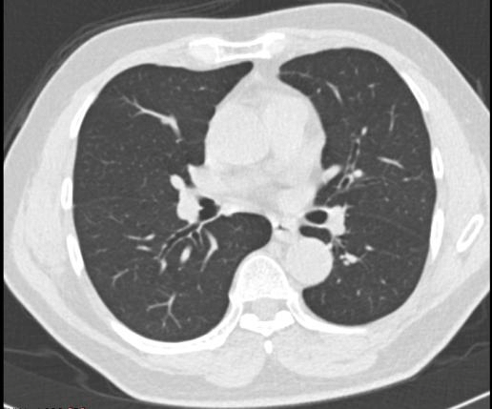
Deep Learning Diseases (DLD)
Ruchit Patel, Winston Yi, Joel Sojan, Tibor Fabry-Asztalos
Team Facebook
June 6th, 2023

Slide 2
Problem:
With manual lung cancer identification techniques, there are uncertainties and possible false positives/negatives associated with this process.
Solution:
This project serves as a tool for medical professionals and researchers for assistance with identifying potential symptoms of lung cancer.
Project Purpose

Slide 3
Goals
Achieve a detection accuracy rate surpassing 70% for valid identification.
Ensure the required time for preprocessing of input data, model training and execution speed are within a tolerable execution time ( No more than 6 hours) for results.
Mitigate issues regarding false positives/false negatives throughout training and testing phase.

Slide 4
Challenges
Difficulty acquiring computation power
Change in Project Scope
Scrum Beginners
Inexperience in Version Control

Slide 5
Challenges (continued)
Final Product
Optimizing train/test runtime
Development Process:
Complex topic required extensive researching
Reaching 70% accuracy threshold
Long training period, changes were slow to propagate

Slide 6
System Overview
Data Preprocessing
Data Extraction and Cropping.
Data augmentation.
Dataset conversion to HDF5.
Lung Cancer Detection ML Model
CNN
36 layers
Hyperparameters:
Epochs: 5
Learning rate: 0.001
Momentum: 0.9
Batch size = 64

Slide 7
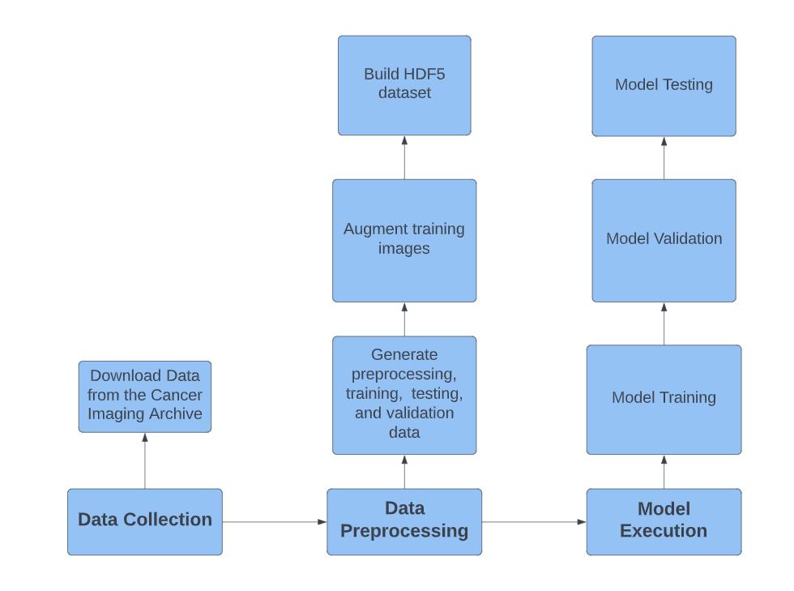
System Overview: Flowchart

Slide 8

System Overview: Dataset
Cancer Imaging Archive Source (www.cancerimagingarchive.net).
A comprehensive collection of annotated CT scans specifically related to lung cancer.
Manually annotated by radiologists.
Contains annotations for positive and negative cases.
Additionally, lung nodule coordinates are annotated.
>1000 .mhd CT files.

Slide 9
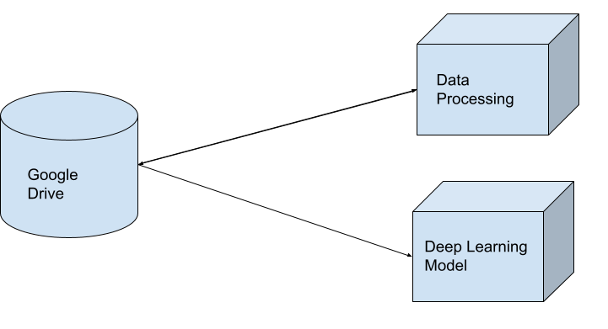
System Overview: Architecture

Slide 10
System Technologies
Data Processing:
Languages:
Python
Notable Libraries:
Tensorflow
Scipy
Model:
Languages:
Python
Notable Libraries:
TensorFlow
Pandas
Scikit
Version Control:
Git
Google Colab
Environment:
Google Colab

Slide 11




System Demo: Preprocessed Output(s)
Positive Cases
Precisely cropped lung nodule images for optimized training, ensuring efficient utilization of data.

Slide 12
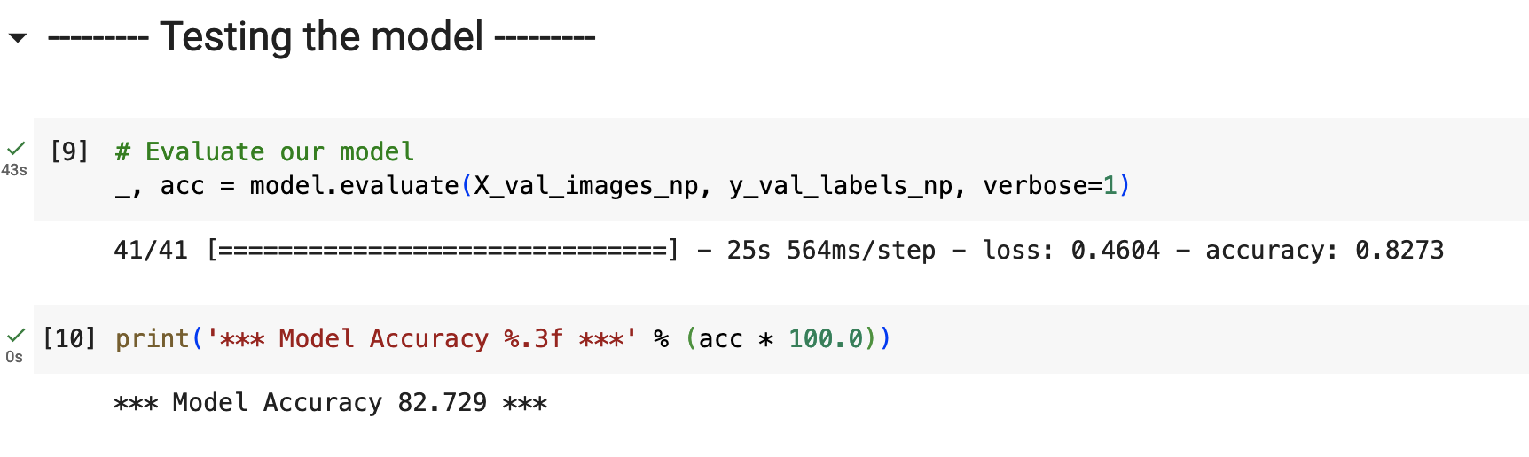
System Demo: Model Eval Output(s)

Slide 13
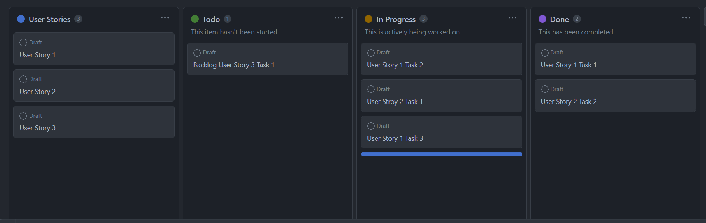
Project Management Techniques
Daily Standups
Version Control (Github)
Task Board (Github)
Burnup Charts
Sprint Plan
Sprint Report
Release Plan

Slide 14
Lessons Learned
Concise Communication
Poor Task Assignments means wasted manpower
Stay true to DoD and Scrum principles
Defects grow
Unclear goals = irrelevant code
Predict velocity
Unrealistic Scope
4) Acknowledge Spikes
a) Improper velocity estimations

Slide 15
Didn’t Enjoy:
Training ML model was time consuming
Extensive research required for implementation
Improving accuracy of model required significant effort.
Start Doing:
Prioritize important User Stories for task assignments.
Follow Scrum principles consistently
Maintain constant communication
Enjoyed:
Working in a team on a common goal
Learning more about ML
Achieving model functionality and improved accuracy as progress milestones.
Project Development Overview

Slide 16
Thank you!

